Slide 1
CREDIT RISK CLASSIFICATION PROJECT
Presented by
Yumna Sohail & Aiman Yasha Naeem

Slide 2
Objective
The main goal of this project is to classify credit risk as good or bad.
To accomplish this we chose a dataset that had a varying complexity i.e. it not only contained mixed variable types but also differed from simple variables like Credit Amount to variables which focused on general wealth of individual.
Due to this, our goal extends to not just classification but also on discerning the different patterns within the dataset.

Slide 3
Summary steps of the project
Data Loading
EDA
Data Cleaning & preprocessing
Custer Formation & Analysis
Training & Testing on individual clusters
Combined cluster performance evaluation
Conclusion

Slide 4
The Dataset
The original dataset has the following characteristics:-
1000 by 22 shape
Both numerical and categorical features
Target label of good or bad
Target label Good:700 samples; target label Bad=300 samples

Slide 5
EDA
During the EDA phase, we delete 4 columns from the original.
This was based on both intuitive as well as practical observations.
The columns included:-
ID
Foreign Worker
Telephone
Relationship Status

Slide 6
The Selected Dataset
Other Parties
Time Owned
Property Type
Age
Other Payment Plans
Living Status
Existing Credits
Job
Dependents
Checking Status
Duration
Credit History
Purpose
Credit Amount
Savings Status
Employment
Installment Commitment

Slide 7
EDA
As you can see that while some features such as Credit Amount, Duration,existing credits,etc may intuitively imply correlation with the Credit Risk target,others such as Living Status, Savings Status, property owned,property type, etc have more complex relationship with credit risk rating.

Slide 8
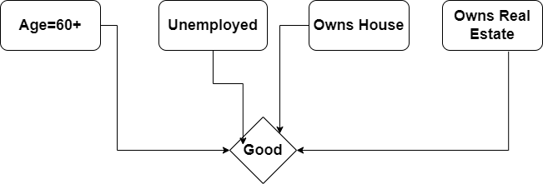
Examples of the complex relationships b/w variables
This image shows
that even though
the applicant is
probably a retiree
he/she might be
considered a good
credit risk.

Slide 9
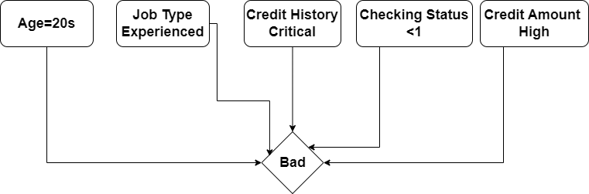
Examples of the complex relationships b/w variables
Here we see
that even the
applicant is young
& in a high-paying
position, his credit
history & banking
information do not suggest a good credit rating.

Slide 10
Clustering
On the basis of the above mentioned complexities we decided to apply clustering to better understand our data and apply it in a meaningful way.
Since many of the variables are ordinal, we decided to apply Spearman's correlation.
The correlation matrix was then used for hierarchical clustering.
We used 2 clusters

Slide 11
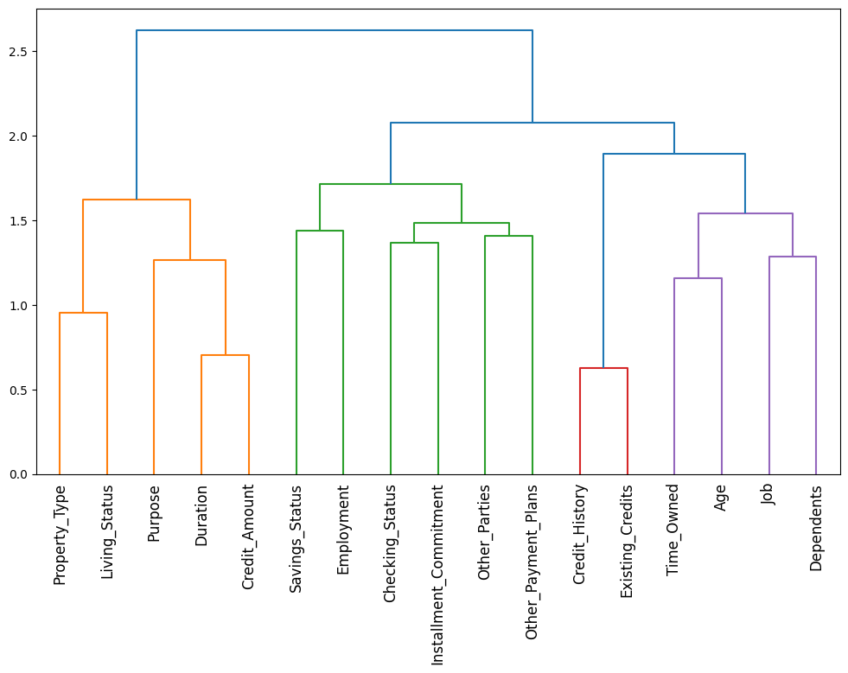
Dendrogram Diagram
The dendrogram
shows us the
degree of
similarities/
similarities b/w
the different
variables.

Slide 12
Model Selection & Train/Test Split
We used Random Forest Classifier for its scalability, robustness and ability to extract complex patterns.
Each cluster had its own X_train and X_test based on its cluster-specific features, while the y_train and y_test remained the same for all clusters.
Accuracy, Precision, recall, F1 score and ROC Curve were used for performance Evaluation

Slide 13
Cluster 1 Performance
Features
Duration
Purpose
Credit_Amount
Property_Type
Living_Status
Accuracy= 0.74
Label | Precision | Recall | F1-Score
Good | 0.81 | 0.83 | 0.82
Bad | 0.56 | 0.52 | 0.54

Slide 14
Cluster 2 Performance
Features
Checking_Status
Credit_History
Savings_Status
Employment
Installment_Commitment
Other_Parties
Time_Owned
Age
Other_Payment_Plans
Existing_Credits
Job Dependents
Accuracy = 0.72
Label | Precision | Recall | F1-Score
Good | 0.77 | 0.87 | 0.82
Bad | 0.53 | 0.34 | 0.42

Slide 15
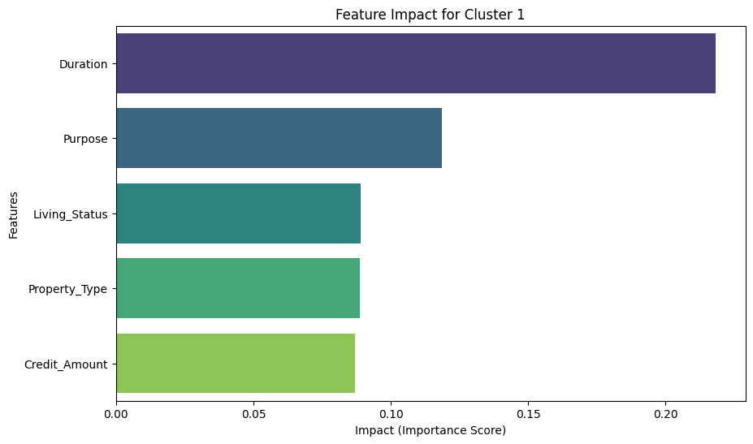
Feature Impact of Cluster 1 on target variable
Cluster 1's correlation
shows that it focuses
more on individual
circumstances.
Importance to property
type & living status
variables suggests
emphasis on property
ownership.

Slide 16
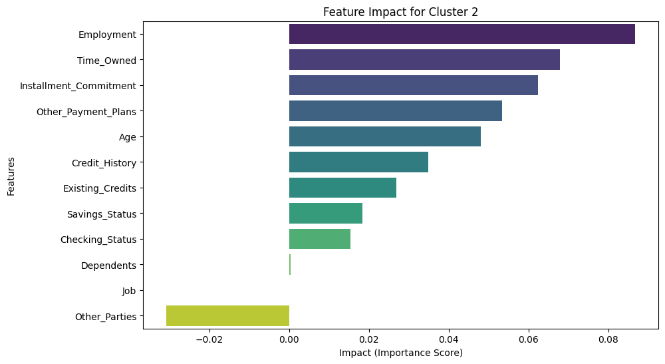
Feature Impact of Cluster 2 on target variable
Cluster 2 is focused
more on secondary
variables. The
general monetary
& investment
capacity of
individuals is
emphasized.

Slide 17
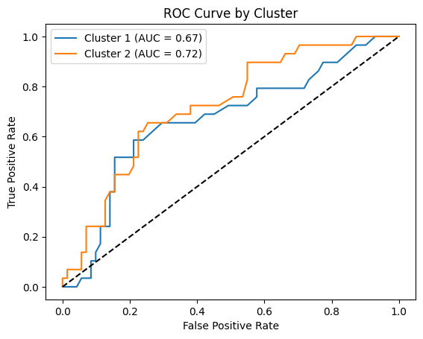
ROC Curve of both clusters
The more general take of
Cluster 2 may be the reason
that it performs better than
Cluster 1 on the ROC Curve,
in spite of Cluster 1 having
better Precision, Recall,
Accuracy & F1-Score.

Slide 18
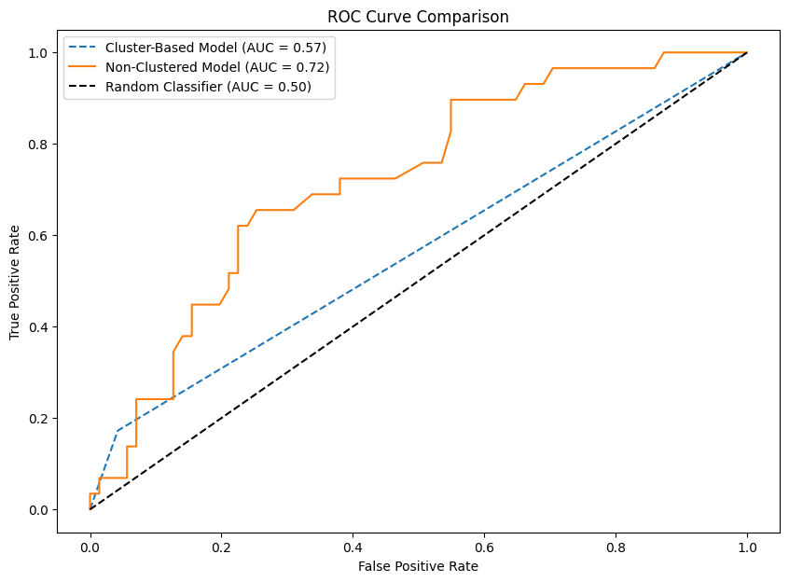
Comparison between clustered-based model & unclustered model using Random Forest
This shows that while
clustering is useful, when
it comes to predictions
the more direct the
information provided to
the model, the more
accurate the results.

Slide 19
Parametric Comparison b/w clustered & unclustered model
Metrics for Combined
Cluster-Based Model
Metrics for Unclustered Model
Accuracy | 0.73
Precision | 0.54
Recall | 0.43
F1-Score | 0.48
Accuracy | 0.76
Precision | 0.67
Recall | 0.34
F1-Score | 0.45

Slide 20
Conclusion
This project demonstrates that clustering is a powerful tool for identifying patterns, however careful algorithm selection & parametric tuning is necessary in order to avoid conflicting clustering results.
At this point, results are somewhat contradictory between clusters themselves as well as the between the clustered and unclustered models.
From a classification point of view, Cluster 1 performs much better than Cluster 2.
Unclustered model shows better Precision & Accuracy, while clustered models shows better Recall and F1-Score.
Results suggest that the clustered model works relatively well but needs more fine turing.
Stratified sampling may also prove helpful since the samples are somewhat unbalanced.

